Slide 1
GSM-BASED DISTRIBUTION TRANSFORMER PARAMETERS MONITORING AND TAMPERING DETECTION SYSTEM
NICHOLAS KIPLANGAT BETT E021-01-0413/2018
BRIAN ONYANGO OKEYO E021-01-0414/2018
PROJECT SUPERVISOR DR. EDWELL TAFARA MHARAKUWA

Slide 2
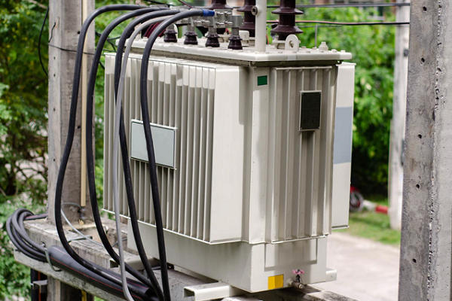
background
Parameters monitoring (oil level, oil temperature etc.)
Tampering detection(oil theft, transformer vandalism etc.)

Slide 3
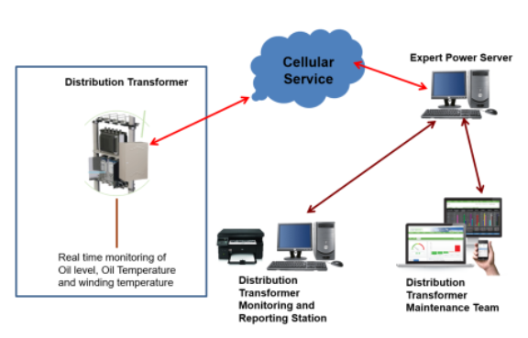
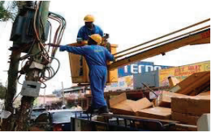
Literature review
Manual monitoring[2].
Online parameters monitoring[3]
Manual tampering detection[4].
Online tampering detection[5].

Slide 4
Problem statement
Conventional distribution transformer parameters monitoring methods are ineffective
Limited distribution transformer tampering detection techniques

Slide 5
objectives
Main Objective
To design a GSM-based distribution transformer parameters monitoring and tampering detection system.
Specific Objectives
To develop a GSM-based distribution transformer parameters monitoring system.
To develop a GSM-based distribution transformer tampering detection system
To evaluate the reliability of the designed system through prototype implementation

Slide 6
justification
Improve health index of distribution transformer.
Effective maintenance of distribution transformers.

Slide 7
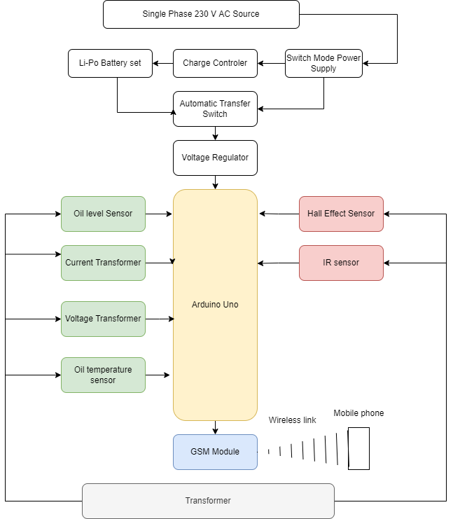
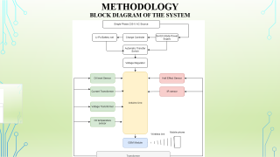
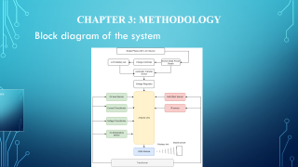
Methodology Block diagram of the system

Slide 8
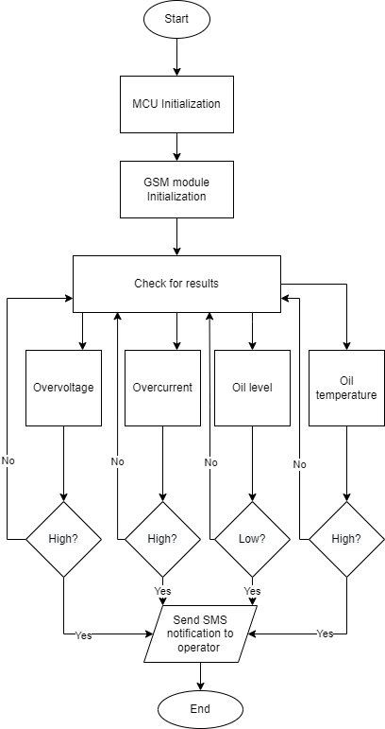
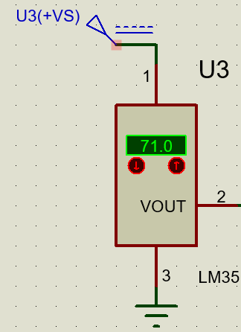
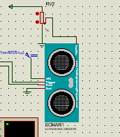
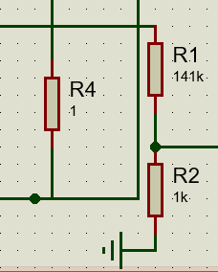
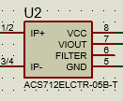
Methodology Parameters monitoring system

Slide 9
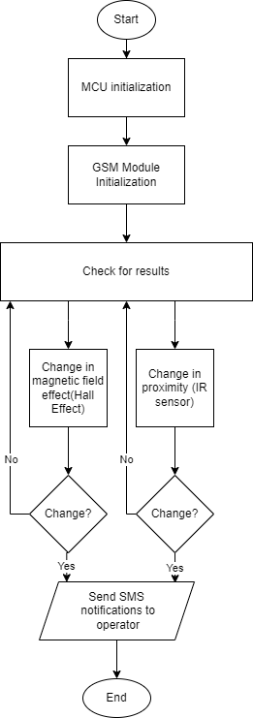
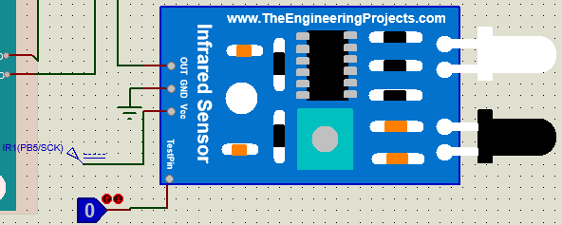
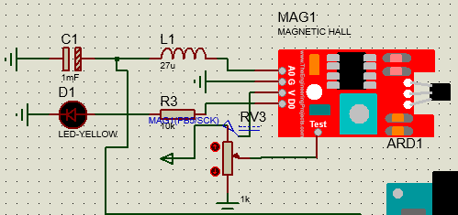
Methodology Tampering detection system

Slide 10
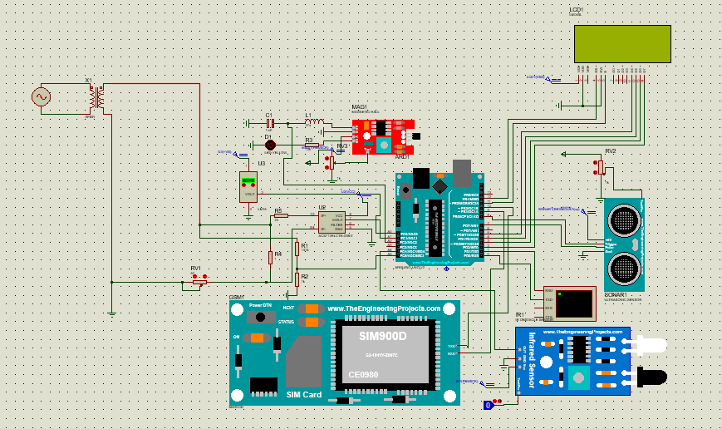
Results And discussion Circuit Design of the Cascaded System

Slide 11
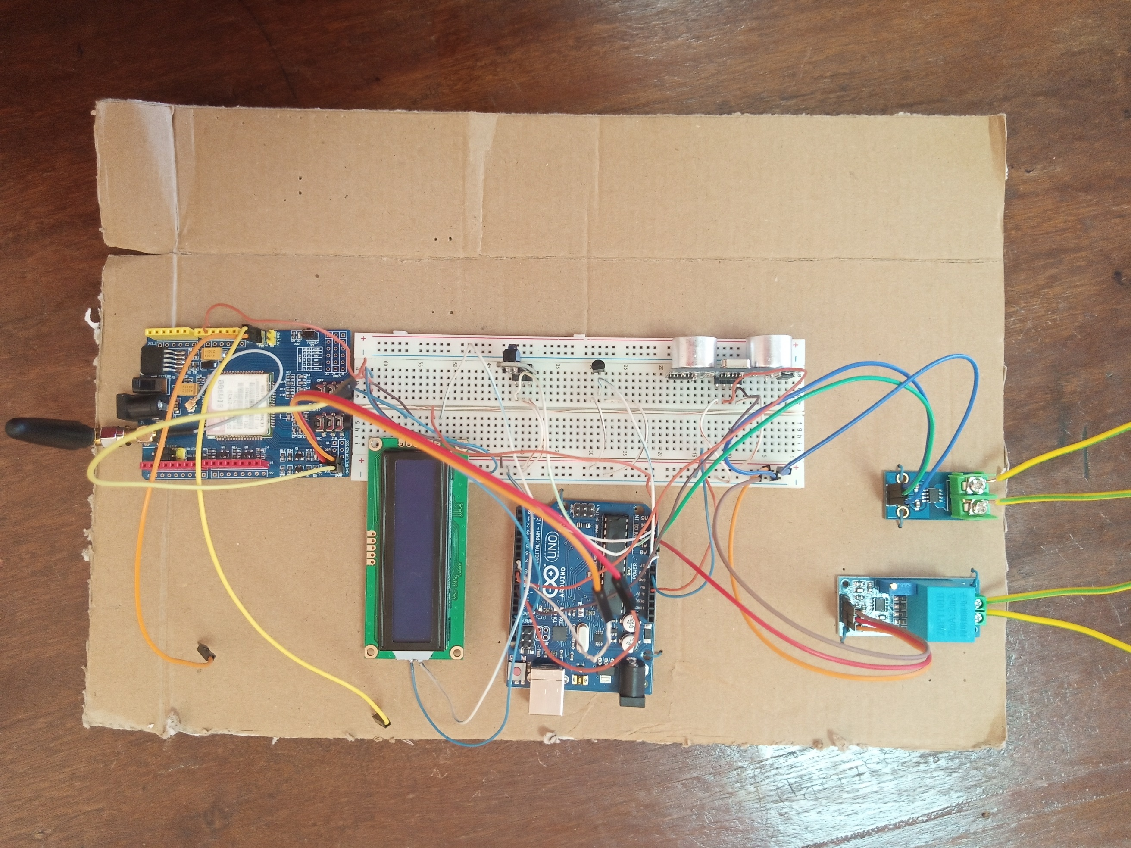
Results And discussion Implemented prototype of the System

Slide 12
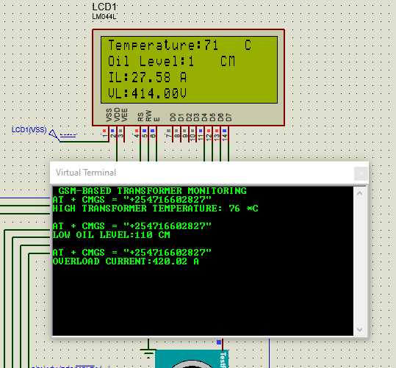
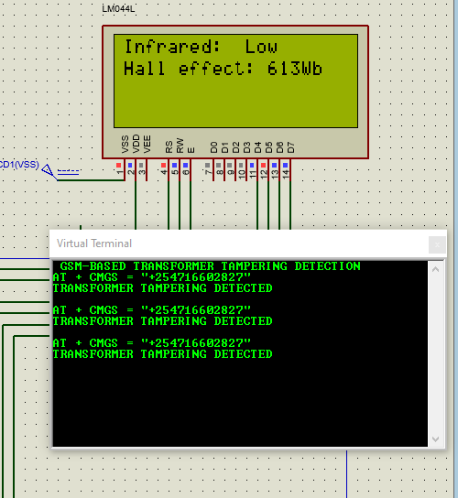
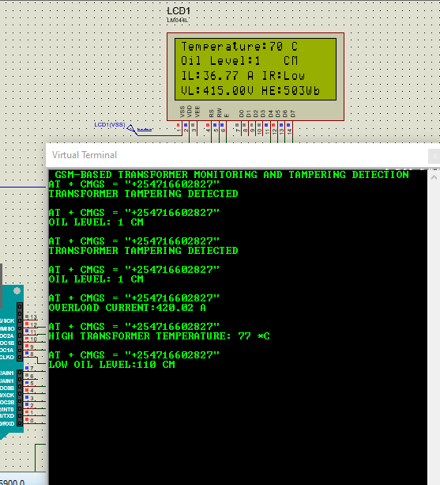
Results And discussion Results of simulation circuits

Slide 13
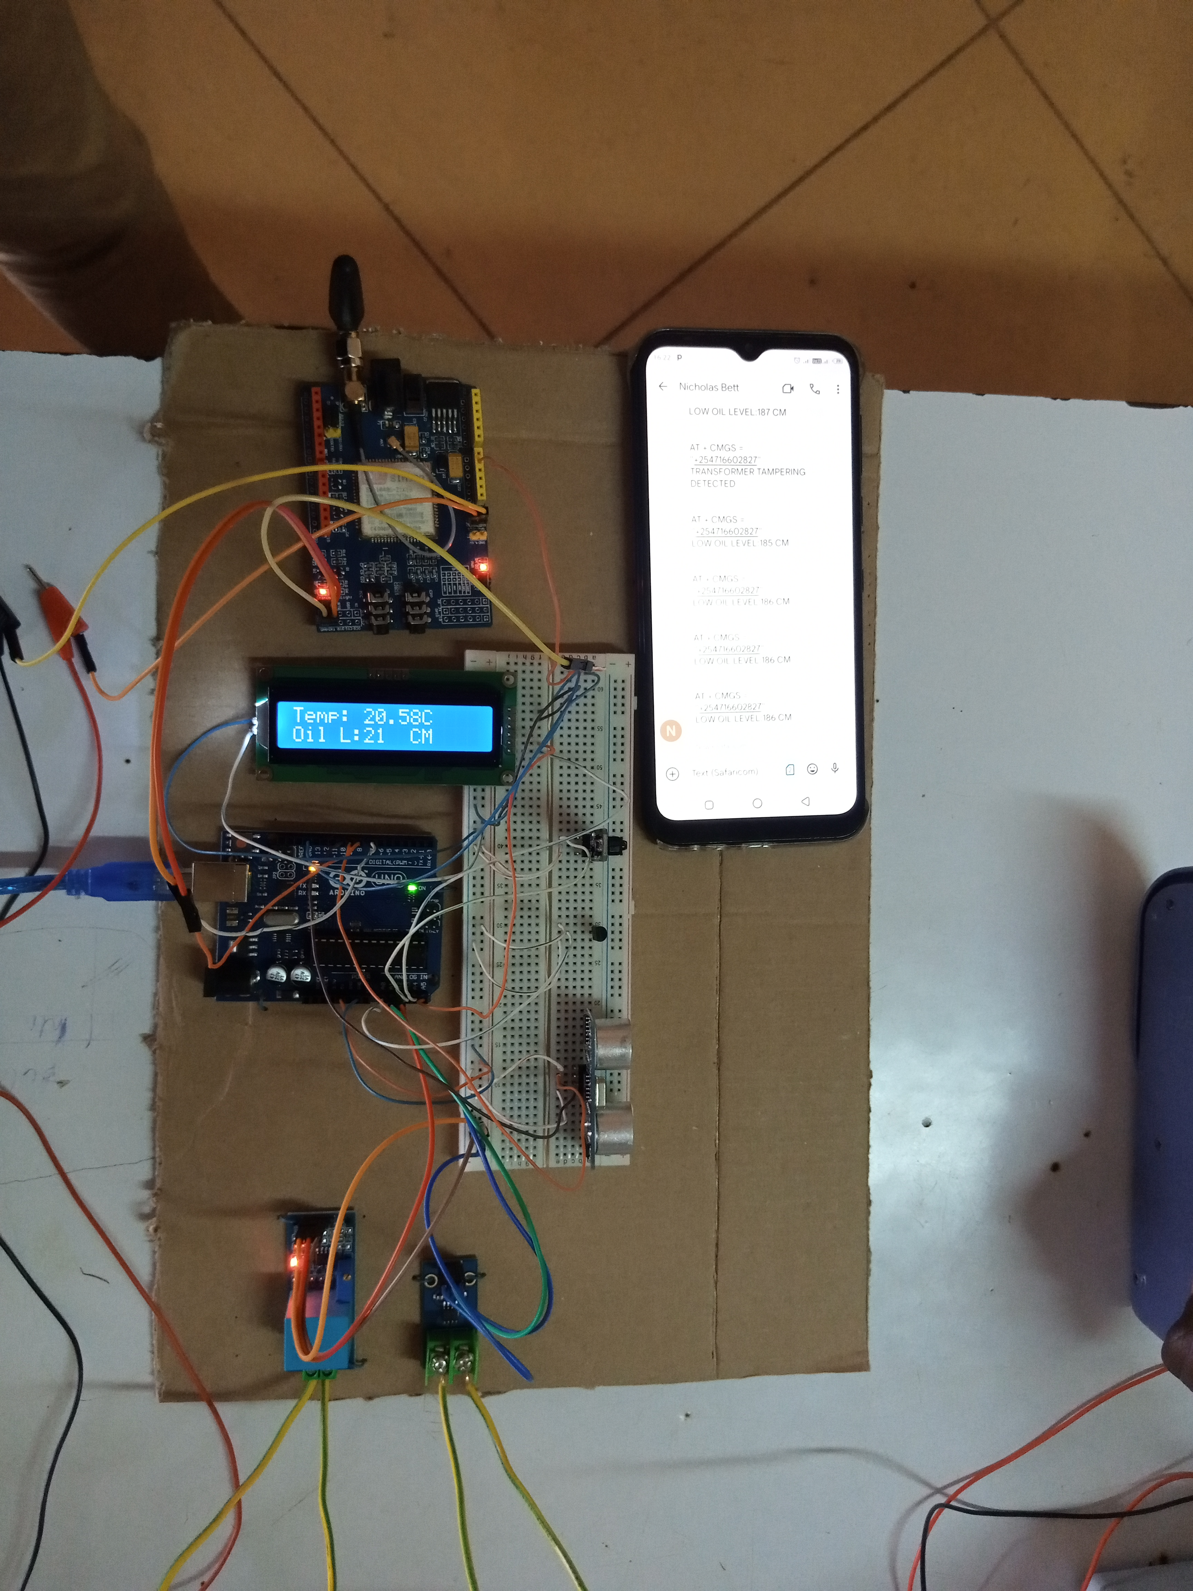
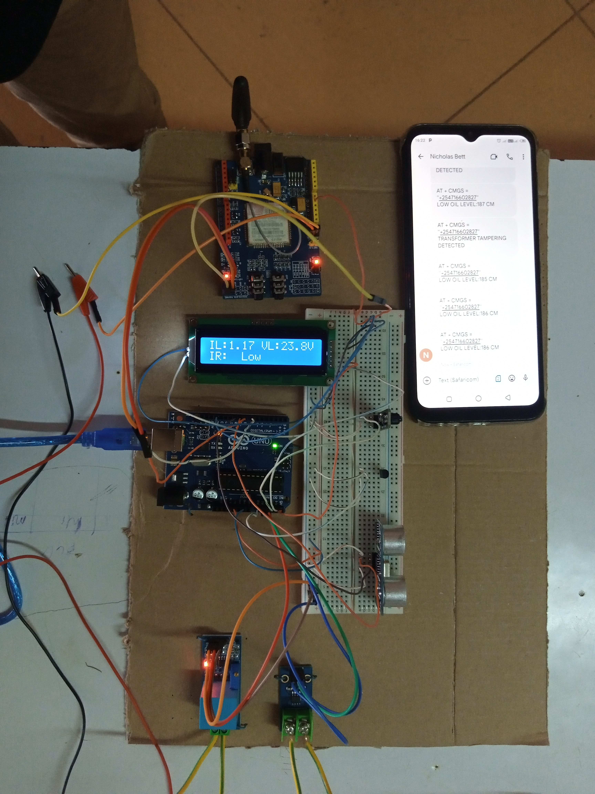
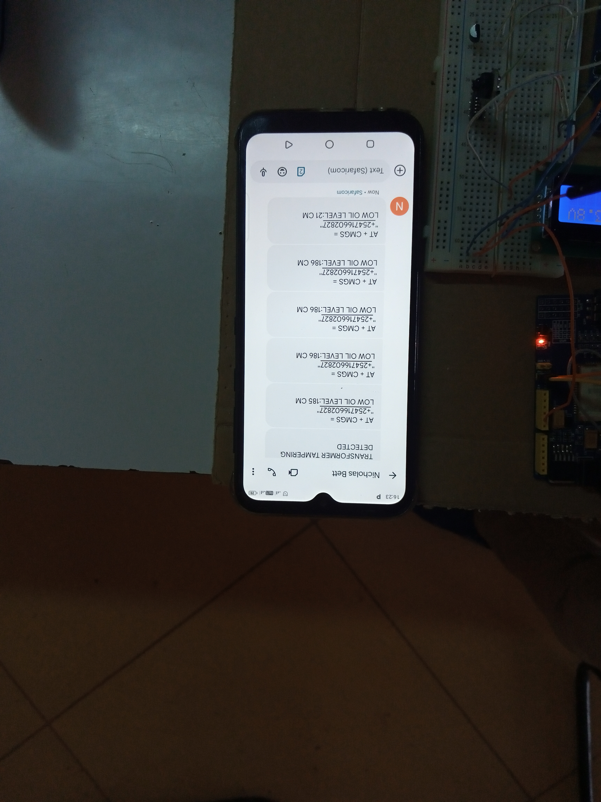
RESULTS AND DISCUSSION Parameters monitoring demonstration

Slide 14
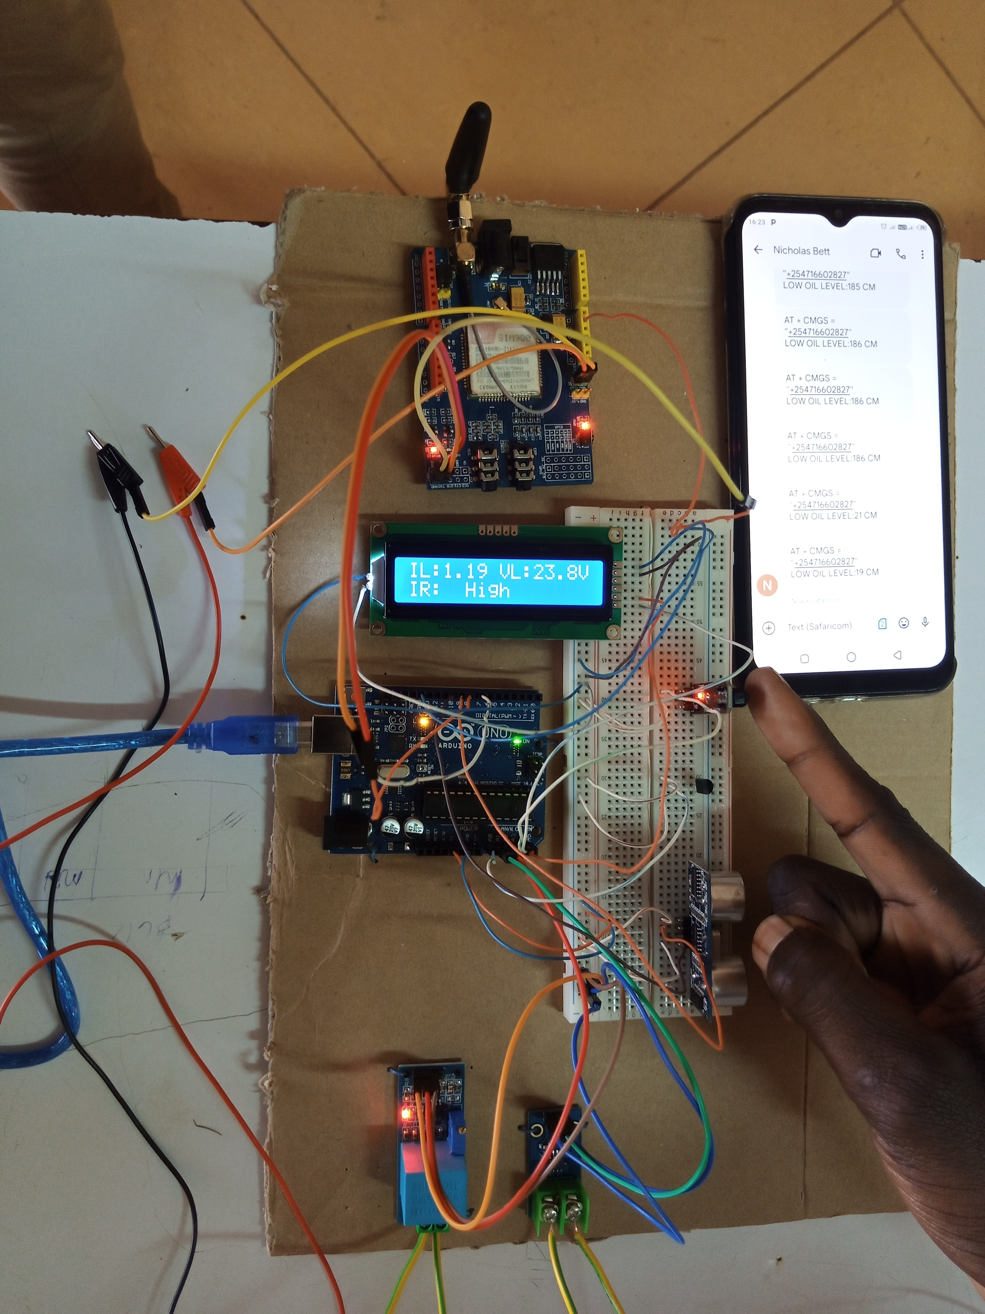
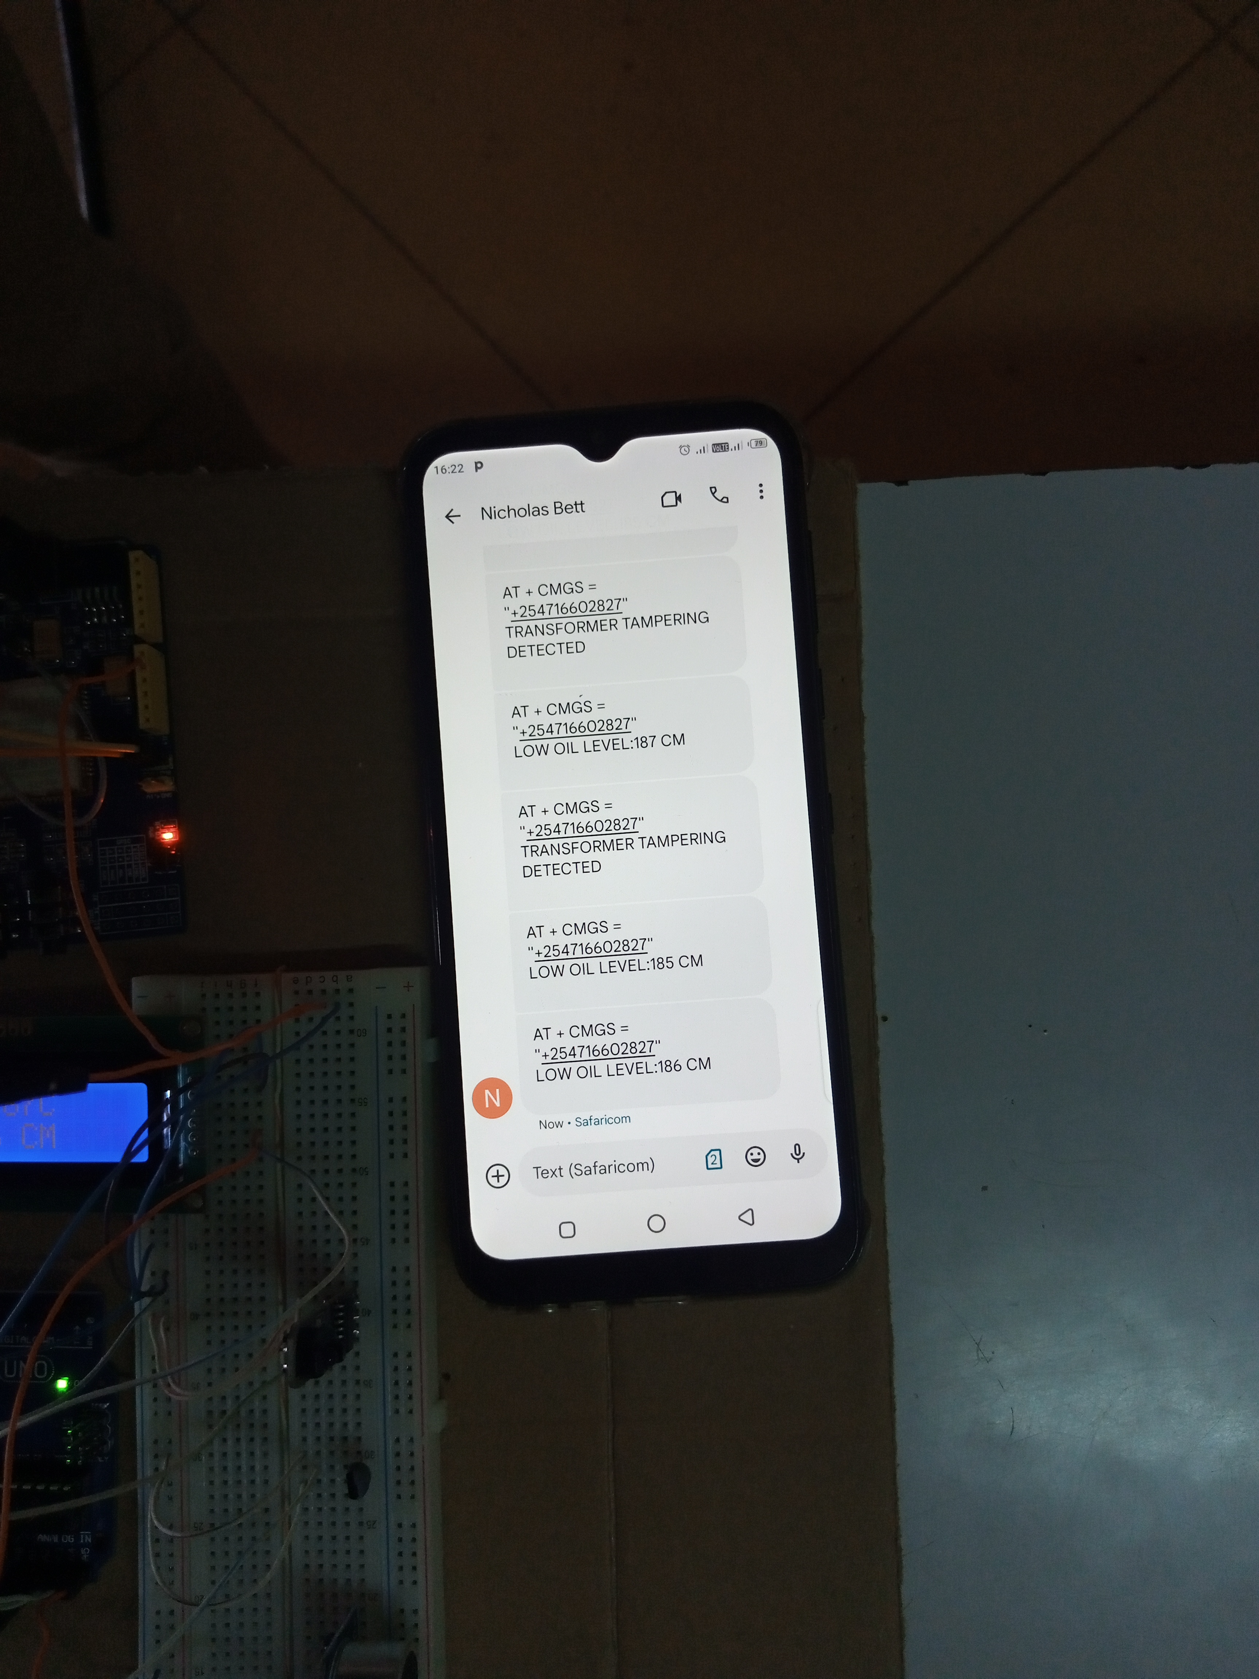
RESULTS AND DISCUSSION tampering detection demonstration

Slide 15
CONCLUSION
Distribution transformer parameters monitoring achieved
Distribution transformer tampering detection achieved
Reliability of designed system successfully evaluated through protype implementation

Slide 16
RECOMMENDATIONs
The system is deployable in real life
Cloud connectivity
Integrate the system with camera network

Slide 17
references
[1] A. Fahim, M. A. Chowdhury, M. F. Alam, F. Elahi, E. C. Shourov, and M. Hasan, “Smart Transformer Theft Protection and Maintenance Monitoring System,” in International Conference on Robotics, Electrical and Signal Processing Techniques, 2021, pp. 607–612.
[2] S. Gaikwad, R. Mehta, P. Shetye, J. Khut, and K. Bani, “GSM based Distribution Transformer Monitoring System.” [Online]. Available: www.ijert.org
[3] “Transformer Protection and Transformer Fault | Electrical4U.” https://www.electrical4u.com/transformer-protection-and-transformer-fault/ (accessed Apr. 08, 2022).
[4] “Theft of transformers brings agony for thousands | Dhaka Tribune.” https://archive.dhakatribune.com/uncategorized/2014/11/06/theft-of-transformers-brings-agony-for-thousands (accessed Apr. 08, 2022).
[5] A. Fahim, M. A. Chowdhury, M. F. Alam, F. Elahi, E. C. Shourov, and M. Hasan, “Smart Transformer Theft Protection and Maintenance Monitoring System,” in International Conference on Robotics, Electrical and Signal Processing Techniques, 2021, pp. 607–612. doi: 10.1109/ICREST51555.2021.9331157.

